Slide 1
Multi-robots navigation in cluttered and dynamic environments
Bruno BORGES DA COSTA, Camilla CARTA, Alexis DEWAELE and Yoann LAPIJOVER

Slide 2
Summary
Introduction
Methodology
Results
Discussion
Conclusion

Slide 3
Introduction

Slide 4
Methodology

Slide 5

1) Reynold’s Rules
Cohesion Rule
$$c\left[i\right]=\frac{1}{N−1}\sum_{j≠i}^{N}{x_{j}}$$

Slide 6

Separation Rule
$$s\left[i\right]=\sum_{j≠i}^{N}{\left\{\begin{aligned}\frac{x_{j}}{{\left\|x_{j}\right\|}^{2}}∙(T_{r2}−\left\|x_{j}\right\|)\text{, }\text{if} \left\|x_{j}\right\|<T_{r2} \\ 0\text{, }\text{otherwise}\end{aligned}\right.}$$

Slide 7

2) Migration Urge
$$R\left(θ\right)=\left[\begin{matrix}\cos{θ} & \sin{θ} \\ \sin{θ} & −\cos{θ}\end{matrix}\right]$$
$$m\left[i\right]=R\left(θ_{i}\right)∙M_{igr}$$

Slide 8

3) Wheel Speed Computation
$$w=\left\{\begin{aligned}b∙v_{max}∙\frac{2}{π}\text{, }\text{if} −\frac{π}{2}<b<\frac{π}{2} \\ 0\text{, }\text{otherwise}\end{aligned}\right.$$
$$u=\left\{\begin{aligned}\left\|speed\right\|∙\frac{\frac{π}{2}−|b|}{\frac{π}{2}} \\ 0\text{, }\text{otherwise}\end{aligned}\right.\text{, }\text{if} −\frac{π}{2}<b<\frac{π}{2}$$

Slide 9
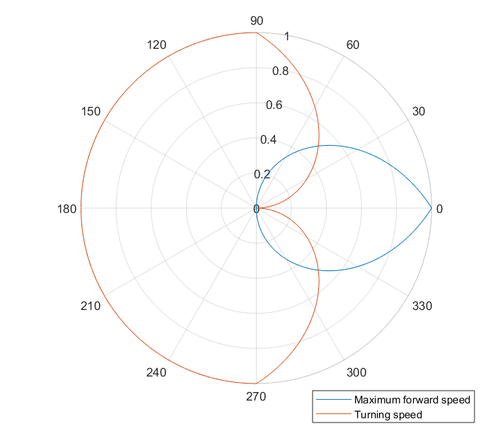
3) Wheel Speed Computation

Slide 10

4) Braitenberg
$$σ+=ω∗sensor_value$$

Slide 11

4) Metrics
Orientation Metric
$$o\left[t\right]=\frac{1}{N}\left|\sum_{k=1}^{N}{e^{iψ_{k}[t]}}\right|$$

Slide 12

Cohesion Metric
$$c\left[t\right]={\left(1+\frac{1}{N}\sum_{k=1}^{N}{dist\left(x_{k}\left[t\right],{\overline{x}}_{k}\left[t\right]\right)}\right)}^{−1}$$

Slide 13

Velocity Metric
$$v\left[t\right]=\frac{1}{v_{max}}max\left(proj_{Φ}\left(\overline{x}\left[t\right]−\overline{x}[t−1]\right), 0\right)$$

Slide 14
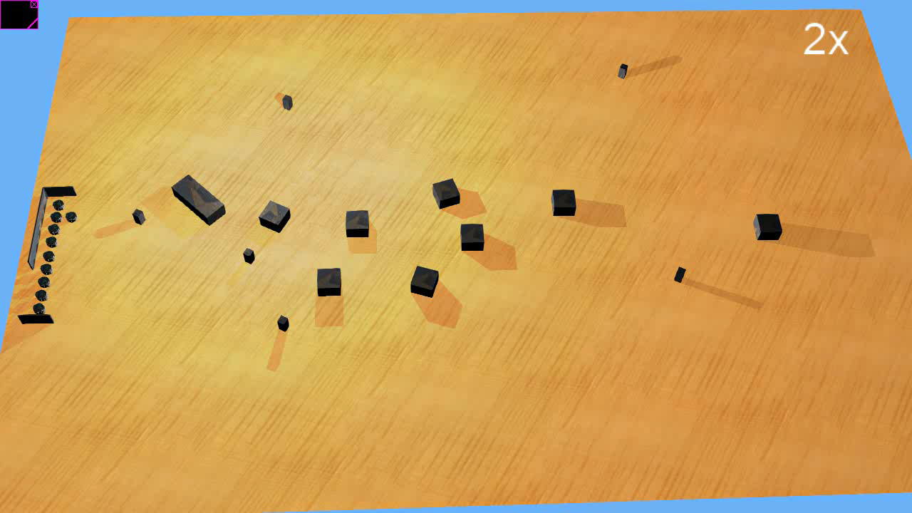
4) Experimental Setup
Simulation in Webots
First Scenario : Cluttered Environment

Slide 15
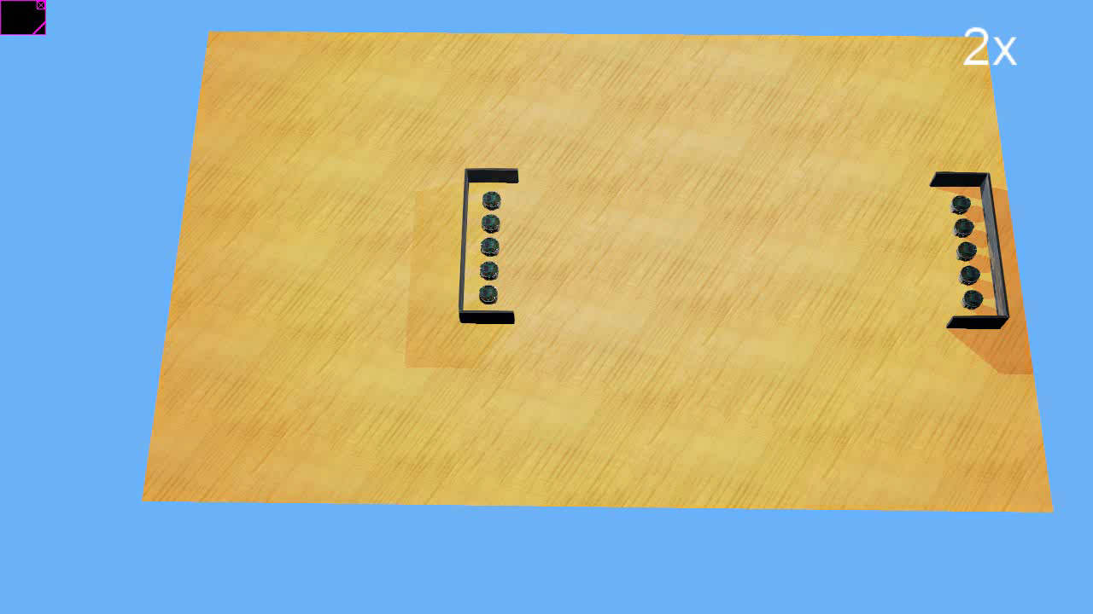
Second Scenario : Dynamic Environment

Slide 16
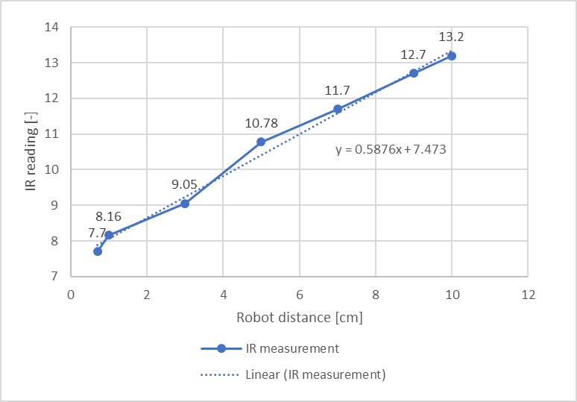
Real Experiments

Slide 17
Results

Slide 18
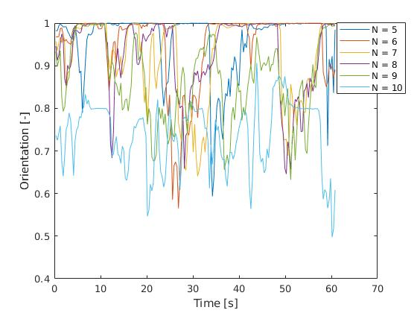
Simulation in Webots
Orientation Metrics for a group of N robots

Slide 19
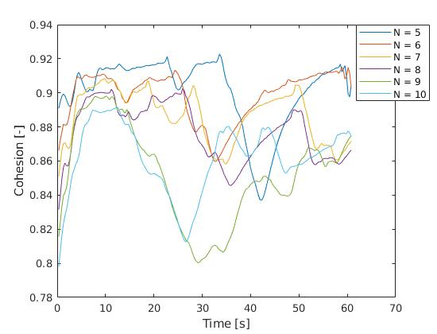
Simulation in Webots
Cohesion Metrics for a group of N robots

Slide 20
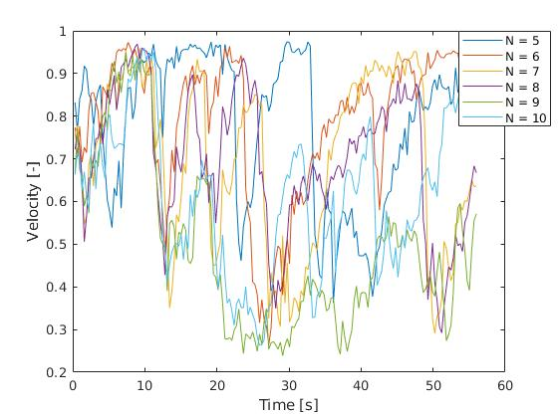
Simulation in Webots
Velocity Metrics for a group of N robots

Slide 21
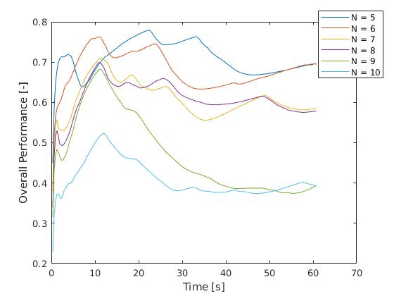
Simulation in Webots
Overall Performance for a group of N robots

Slide 22
Real Experiments

Slide 23
conclusion

